Slide 1
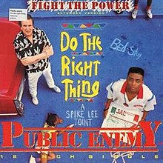

“Public Enemy”
Hip Hop as an Agent for Social Change
Members of HNR 2503, feat. JW Turner

Slide 2
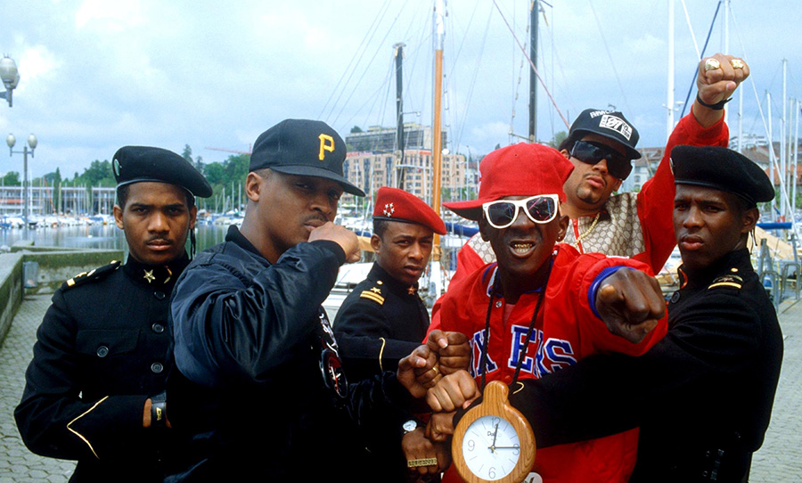
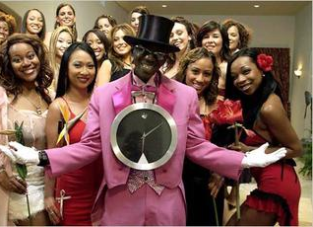
Public Enemy
Public Enemy in 1989
“Flavor of Love” in 2006-08

Slide 3
Black Nationalism
As the rhythm's designed to bounce
What counts is that the rhyme's
Designed to fill your mind
Now that you've realized the pride's arrived
We got to pump the stuff to make ya tough
“Wake up Call”:
Don’t buy in to institutional racism
Push back … “Fight the Power”
Cause I'm Black and I'm proud
I'm ready and hyped plus I'm amped
Most of my heroes don't appear on no stamps
Sample a look back you look and find
Nothing but rednecks for 400 years if you check
Be proud of who you are
Malcolm X: “Who taught you to hate?”
400 years: since the founding of Jamestown in 1607

Slide 4
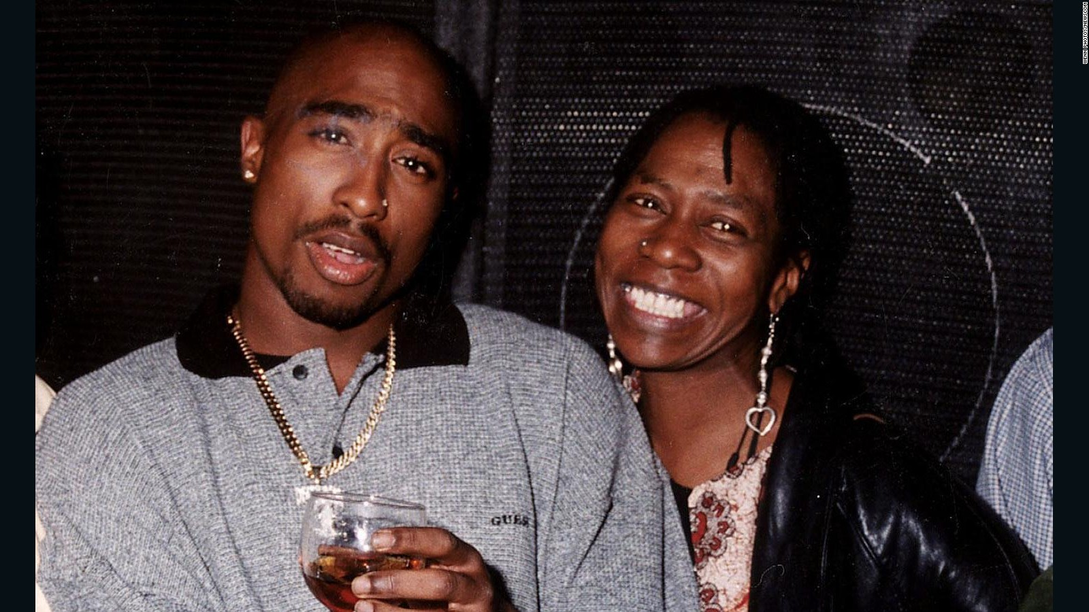
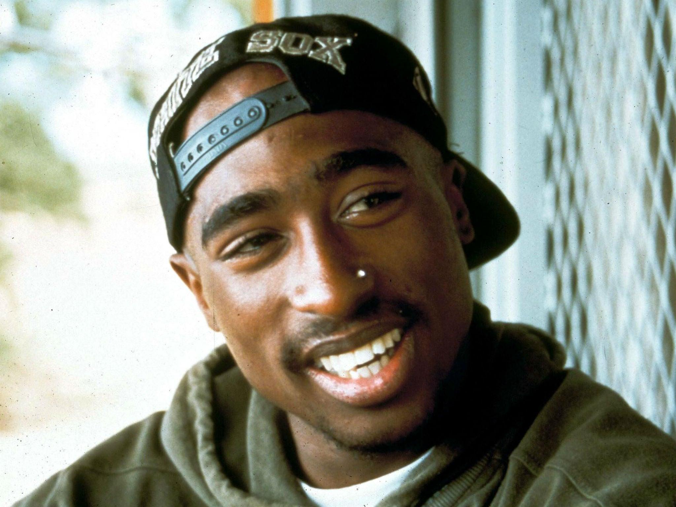
Tupac
Background
Born in Harlem, NY
Baltimore School for the Arts
Marin City, California
Afeni Shakur - Black Panthers
Father absent ages 5-23
Crack addiction
Love for Hip-Hop and poetry obsession
“The thing that bothers me is that it seems like a lot of the sensitive stuff I write just goes unnoticed”

Slide 5
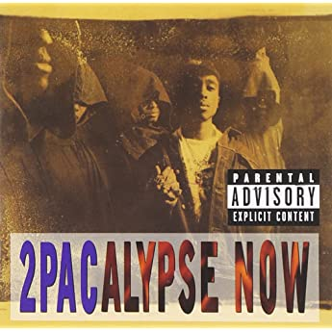
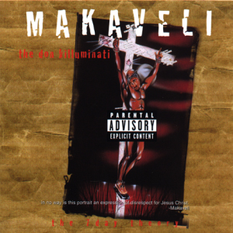
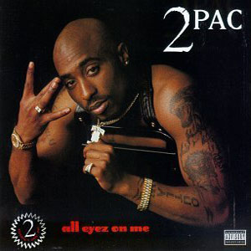
Tupac
Music Career
Rose to fame from his 1991 album 2Pacalypse Now
Vice President Dan Quayle declared Tupac’s music had no purpose
Created his own label in 1993 called Thug Life
Me Against the World, his third album, got him to stardom
Tupac’s album “All Eyez On Me” is his biggest and best selling album next to his “Greatest Hits”album released in 1998
His final non-posthumous album The 7 Day Theory was recorded in August prior to his death in 1996, but released shortly after under the stage name Makaveli

Slide 6
Tupac
“Changes” -1998
First ship 'em dope and let 'em deal the brothers
Give 'em guns step back watch 'em kill each other
And still I see no changes can't a brother get a little peace?
It's war on the streets and the war in the Middle East
Instead of war on poverty they got a war on drugs
Both of these sections from changes present amazing examples of conscious issues that were affecting the US and black communities at the time.
One of the main topics in the song is about how the US government was selling drugs to poor communities and how this was destroying them.
Later in the song Tupac speaks about how these issues caused the black communities to change.

Slide 7
Tupac
“Only God Can Judge Me”
Released in 1996 as a part of the All Eyez on Me album.
The song is Tupac’s way of conveying his pain concerning about how many black men turn to a life of crime.
Tupac incorporates his love towards his home and those who helped him achieve success.
According to Jordan Peterson’s Rubric, I would score the song
DRR : 9
Space and Place : 10
Artistic Persona : 7
Lyrical Rhyme and Flow : 10
Historical Knowledge and Respect : 8

Slide 8
Tupac - “Only God Can Judge Me”
'Cause the streets got our babies, we gotta eat
No more hesitation each and every black male's trapped
And they wonder why we suicidal runnin' round strapped
There's a ghetto up in Heaven and it's ours, Black Power
Is what we scream as we dream in a paranoid state
And our fate, is a lifetime of hate
Tupac is addressing the social idea concerning that many black men turn to a life of crime and drugs, because they want too. Instead, he confronts said idea by explaining that many black men are forced to turn to such a lifestyle, in order to survive.
He further strengthens his claim by addressing that the lifestyle that surrounds black men is one of chaos and hatred. Again, addressing the fact that a life of crime can offer a sense of security and safety, if only temporary.

Slide 9
Tupac - “All Eyez On Me”
It ain't right: parasites, triggers, and fleas crawlin'
Sucker, duck and get busted, no emotion
My devotion is handlin' my business, nigga, keep on coastin'
Where you goin', I been there, came back as lonely, homie
The feds is watchin', niggas plottin' to get me
Will I survive? Will I die? Come on, let's picture the possibility
Givin' me charges, lawyers makin' a grip
I told the judge I was raised wrong and that's why I blaze shit
“All Eyez On Me” is a good example of a gangsta song with a conscious side. In this line, Tupac is addressing the rather dismal conditions of his current location, likely referring to a ghetto or low income housing project. He further addresses that his lifestyle has left him cold and empty, both emotionally and mentally.
Here Tupac acknowledges the inherent risks of a gangsta lifestyle and accepts them. Further, he addresses that it was not his choice to take on this life, rather, his surroundings influenced him.

Slide 10
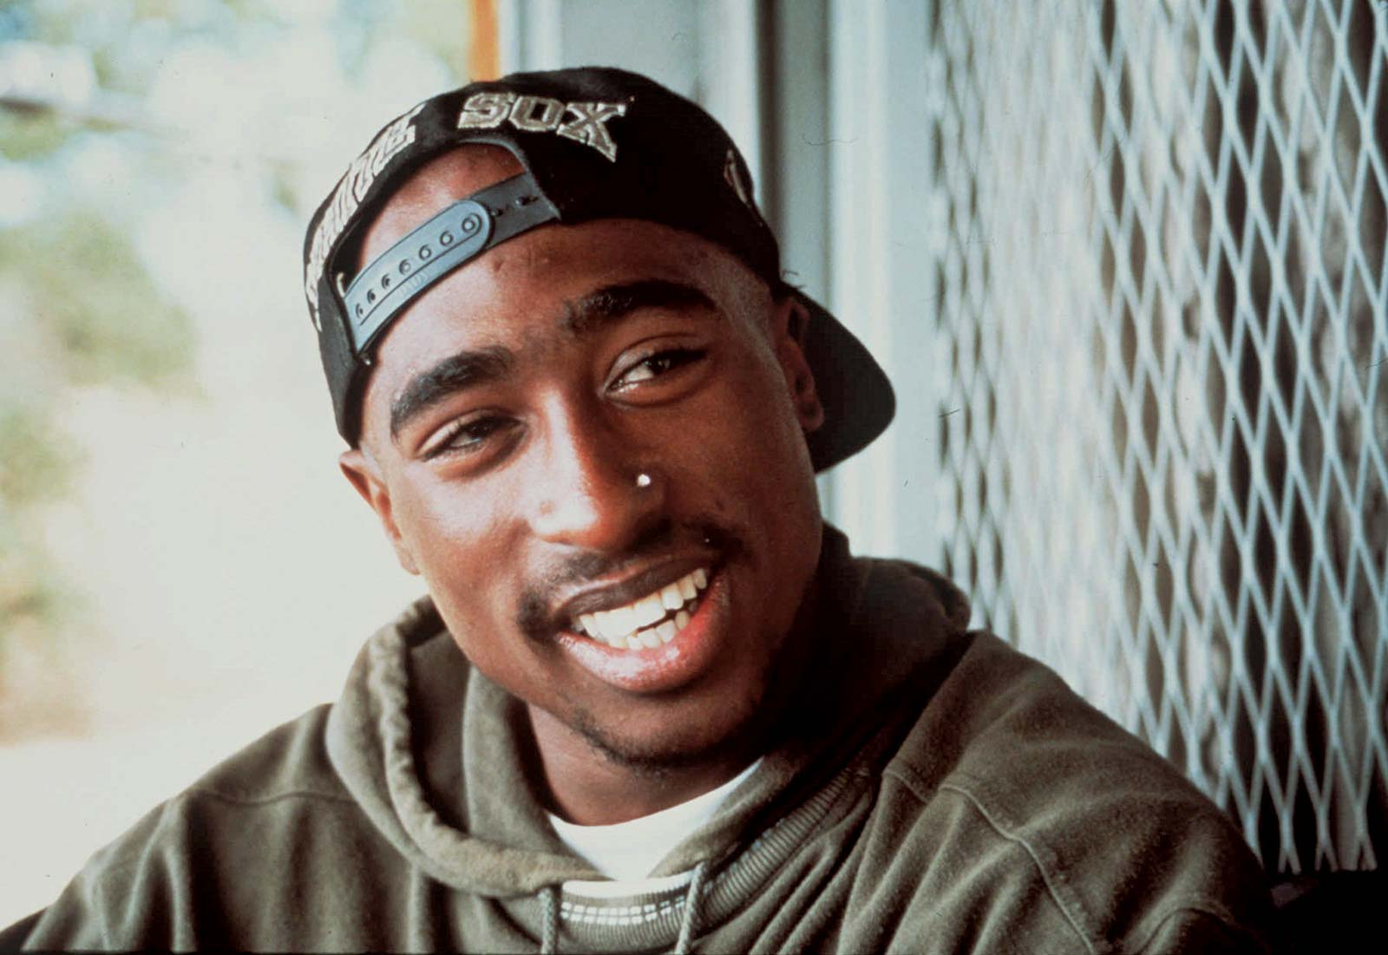
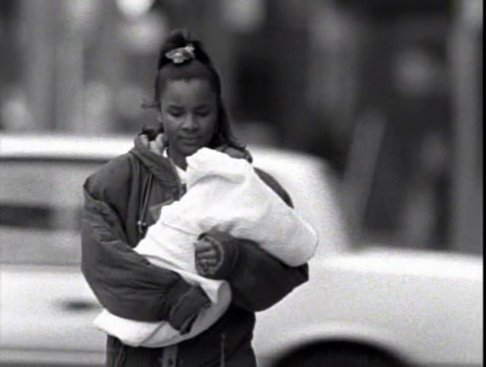
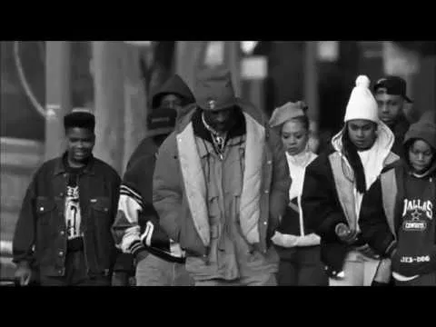
Tupac
“Brenda’s Got a Baby
I hear Brenda's got a baby But, Brenda's barely got a brain
A damn shame, the girl can hardly spell her name
(That's not our problem, that's up to Brenda's family)
Well let me show ya how it affects the whole community
Tupac elaborates on how situational issues affect entire communities
Begins with her father’s drug addiction and ends with Brenda’s death
First hip hop artist to narrate the problems that young women were facing in impoverished areas

Slide 11
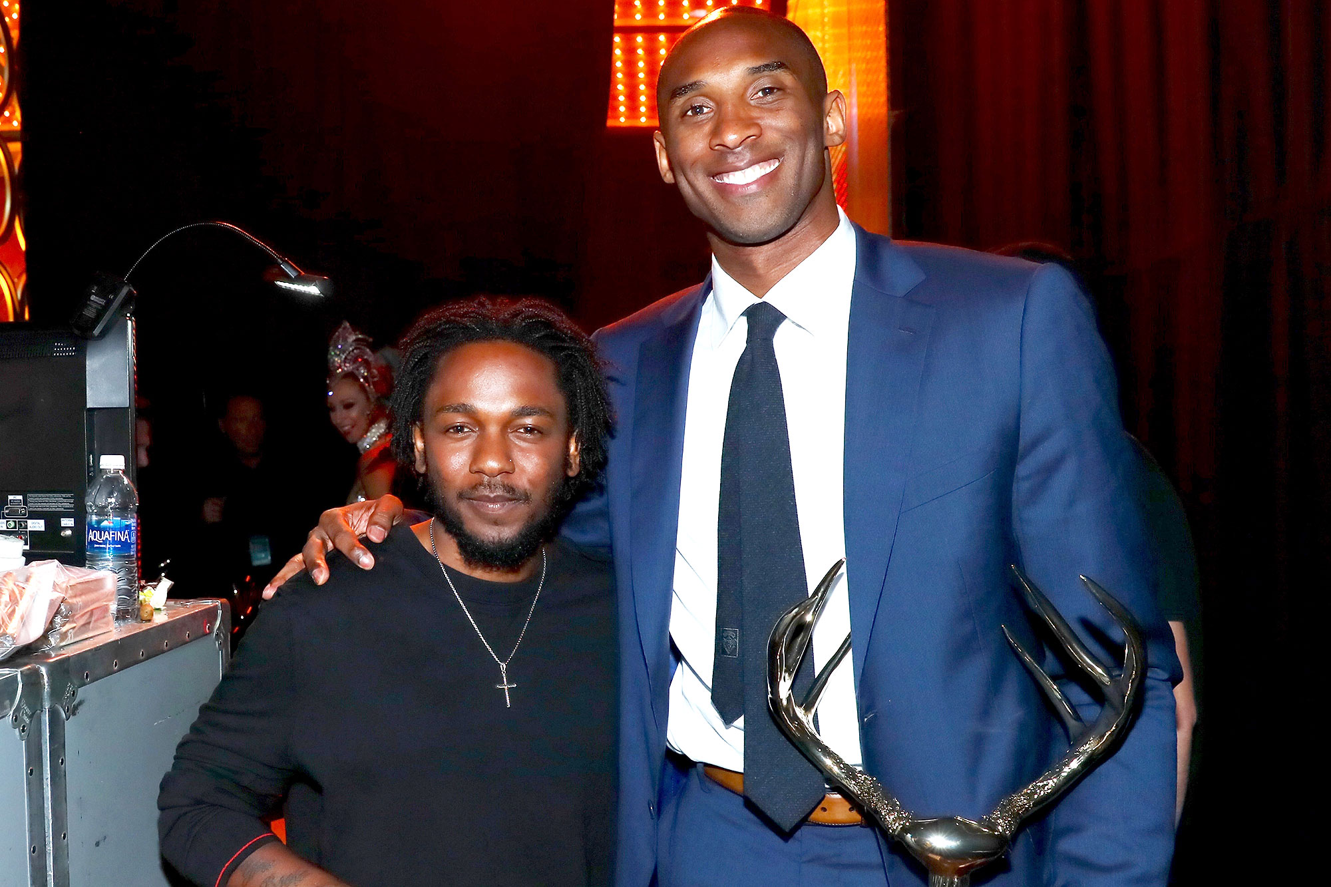
Kendrick Lamar
A modern protest against institutional racism
West Coast icon
The one that escaped
Compton, as Kendrick describes, is a mad city
Gang life, sex, drugs
Institutional racism trickles down causing impoverished areas to stay impoverished
“Alright” is the anthem for West Coast Black Lives Matter protests
Song speaks of his trials and tribulations growing up in Compton but how he still made it out and how everyone else can be “alright” as well
Christian themes
Notes:
Kendrick provides hope for a better tomorrow for the people of Compton and those around the nation coming from similar areas
His songs show his journey traversing a gang life that was established because of the institutional racism not allowing minorities in the area to have productive and self-sustaining jobs
“Institutionalized”
“m.A.A.d. city”
There were temptations all around him, but he used his talent and will to get out
Didn’t stop there however, because he returned and highlighted the injustice occurring there so society could see that change needed to occur
good kid, m.A.A.d. city and To Pimp A Butterfly
Play Kendrick’s intro to “Alright”

Slide 12
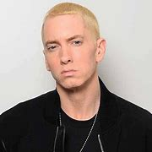
Eminem
Background:
Born on October 17, 1972 in St. Joseph, Missouri as Marshall Bruce Mathers III
He kept having to move around with his mother and ended up in Detroit, Michigan
Met Kim Ann Scott (13) when he was 15 and began dating
He dropped out of school at 17 and his mother kicked him out of the house
1995 - He and Kim had their daughter Hailie Jade Scott
1999 - a lawsuit from his mother for $10 million over defamation claims
Notes:
His father left when he was an infant, making him be raised by single mother
Once in Detroit, he was continuously bullied by the African American children from the neighborhood
He did not have a good relationship with his mother as he accused her of being addicted to prescription pills as well as being emotionally and physically abusive towards him
He dropped out of school due to a bad home life and poor relationships with his peers
The couple would keep splitting and getting back together, until finalizing the split in 2006 resulting in a dispute over custody of their daughter
Lawsuit was settled for $25000

Slide 13
Rap Background
Eminem excelled in his English classes in school which assisted in his ability to create rythmes
He began his rap career with his friend Mike Ruby a.k.a Proof
Infinite was his first solo album, released in 1996
1999 - His Slim Shady LP went multi-platinum, earning him 2 Grammys and 4 MTV awards
2000 - Marshall Mathers LP which is noted as the fastest selling album in rap history
2002 - “Lose Yourself:\” won Academy Award and his semi-autobiographical movie 8 Mile was released
2010 - His album Recovery won a Grammy as well
He won numerous other accolades in 2013, 2017, 2018 and his new music is still very popular
Notes:
Spent much of his free time reading comics which helped his creative process
This is also how he practiced and gained the ability to connect phrases together to better his flow
Him and Proof made a few songs and albums together and began to get recognition in the rap scene
This album was focused on his daughter and he needed to make more money
Recovery was focused on his journey through rehabilitation from his addictions

Slide 14
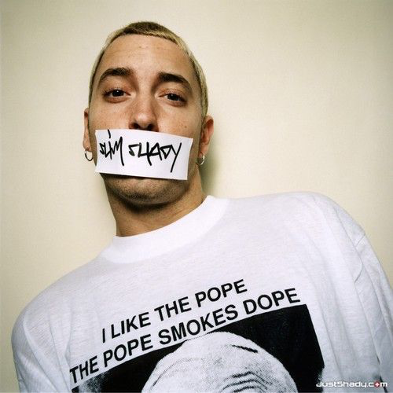
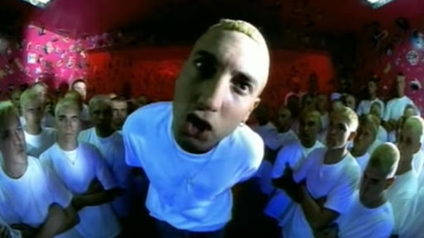
Slim Shady
Who is “Slim Shady?”
Appearance
How he dressed
Race
Wild Card
Humor, self-deprecation, controversial

Slide 15
Real Slim Shady
Surface level of the song: Slim goes off in outrageous fashion on his critics, throwing in loads of pop culture/celebrity references along the way. It is meant to be a parody of stereotypical pop songs.
Deeper Meaning: Song criticizes mass media as being hypocritical, and everyone is entitled to think and say what they want regardless of what others say.
Lyrical examples:
“Sometimes I wanna get on TV and just let loose, But can't, but it's cool for Tom Green to hump a dead moose.”
“I'm like a head trip to listen to, ‘cause I'm only givin' you, Things you joke about with your friends inside your livin' room, The only difference is I got the balls to say it in front of y'all, And I don't gotta be false or sugarcoat it at all”
“Of course, they're gonna know what intercourse is, By the time they hit fourth grade,They've got the Discovery Channel, don't they?”
“And every single person is a Slim Shady lurking”

Slide 16
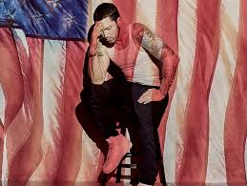
Eminem
Distinct Lines from the song:
“Hands up, officer don’t shoot
Then pull your pants up, promise you won't loot
We may never understand each other, it’s no use
We ain’t ever gonna grasp what each other goes through”
“White boy, white boy, you're a rockstar...
White boy, white boy, in your cop car...
White boy, white boy, you're untouchable”
“Sendin' white cops in the black neighborhoods
Who ain't acclimated to 'em, like that's the way to do it
Who seen some fuckin' videos of rappers waving guns
And know nobody black so they act afraid of us
And that's racism, the fear that a black face gives 'em”
“And streets act as a narrator, don't gotta read comics
Or be that into characters, just to see that, just to be black
You better be strapped with a derringer
Or be “capped in America” like Steve Rogers”
“Untouchable” in his Album Revival

Slide 17

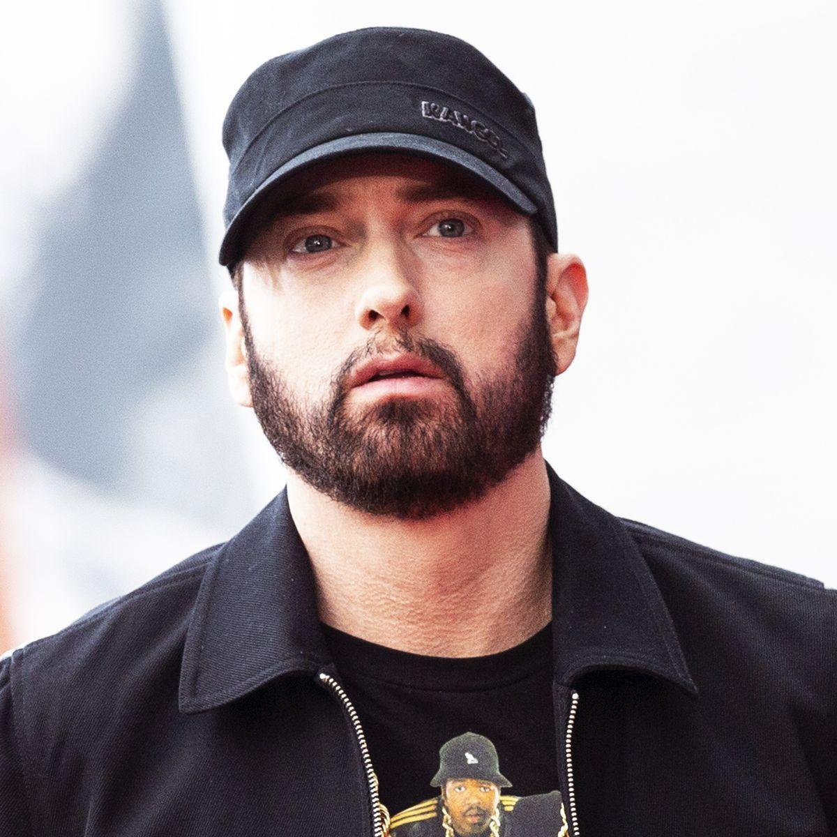
Present Eminem
-Becoming opposite of what he used to be
-More political
-Mainstream songs in new album -ex. Godzilla ft. Juice Wrld
-slim shady almost nonexistent

Slide 18
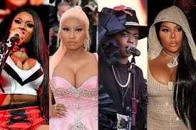

Women in Hip-Hop
Men’s voices were dominant in protests and Hip-Hop
Females are using their music to protest the industry
Only one great female rapper at a time in the past
This past year Megan Thee Stallion, Lizzo, Cardi B, City girls, and many more all hit top charts
More individuality than men
Leads to many types of female Hip-Hop
Two extremes
More feminine
More masculine
4th Wave Feminism
Women’s Hip-Hop is still criticized and they need to prove themselves, but men never had to
Notes:
-Men have always had a predominant voice in both Hip-Hop and protests in general
-As female rappers grew in popularity, they started using their voices and music to protest the division in the music industry
-At first, only one great female rapper was seen at a time. However, that is beginning to change. As we saw in 2019, Megan Thee Stallion, Lizzo, Cardi B, City Girls, and so many other female Hip-Hop artists all hit top charts. Lizzo’s song “Truth Hurts” even broke records for having the longest reign for a female rap song
-Nowadays, it can be argued that female rap has more individuality than male rap. This is because of the two extremes that female Hip-Hop has become. (more feminine and more masculine)
-4th wave feminism also ties into why these two extremes have developed
-Many people still criticize women in Hip-Hop for being “too this or too that” so they have to prove themselves in order to sell, which men never had to do that
Michaela

Slide 19
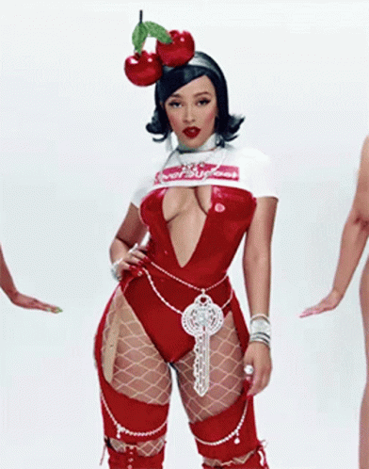
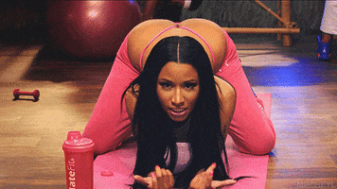

“More Feminine”
Nicki Minaj, Doja Cat, Cardi B, Flo Milli
Newer “If you’ve got it, flaunt it” philosophy
Simultaneously reject and embrace sexual stereotypes
Reject: challenge the “skinny white girl” beauty standard
Embrace: hypersexualize themselves in an empowering way
Most prominent in music videos and artistic persona
Challenges what is socially acceptable
“Anaconda” music video
“Barbie Dreams”
Notes:
Some examples of hyperfeminine artists are Nicki Minaj, Doja Cat, Cardi B, and Flo milli
These artists embrace the newer “If you’ve got it, flaunt it” philosophy that teaches a younger female audience that showing off their bodies is a positive thing
They also simultaneously reject and embrace sexual stereotypes
They reject them by: challenging the “skinny white girl” beauty standard: these artists are usually non-white and promote having curvy or thick figures, which is especially uplifting to young people of color (intersectionality, 4th wave feminism)
They embrace them because they: hypersexualize themselves in an empowering way: they want to do this to themselves before men get the chance to do it to them, this is a way of taking back the power
Their femininity is most prominent in music videos and in their artistic personas: by showing off their bodies, the clothes they wear, and their overall attitude towards sex
They Challenge what is socially acceptable
“Anaconda” music video: created so much controversy back in the day, now these artists are releasing music videos like this every month and the public does not bat an eye
Anna + Steph!

Slide 20
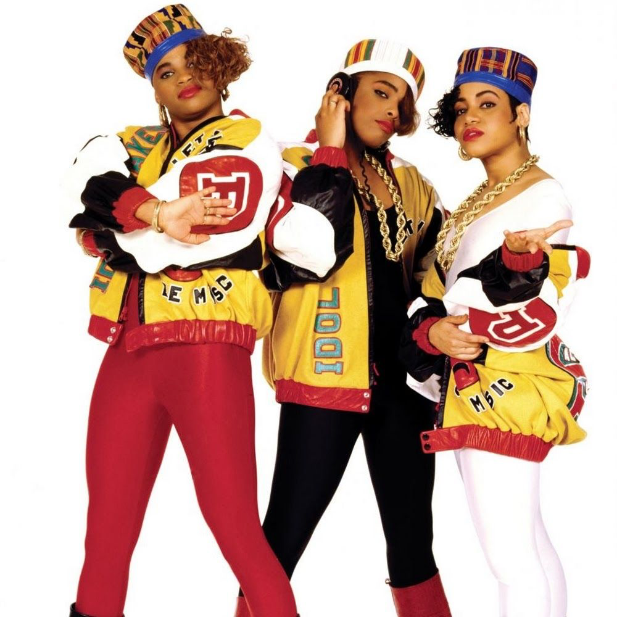
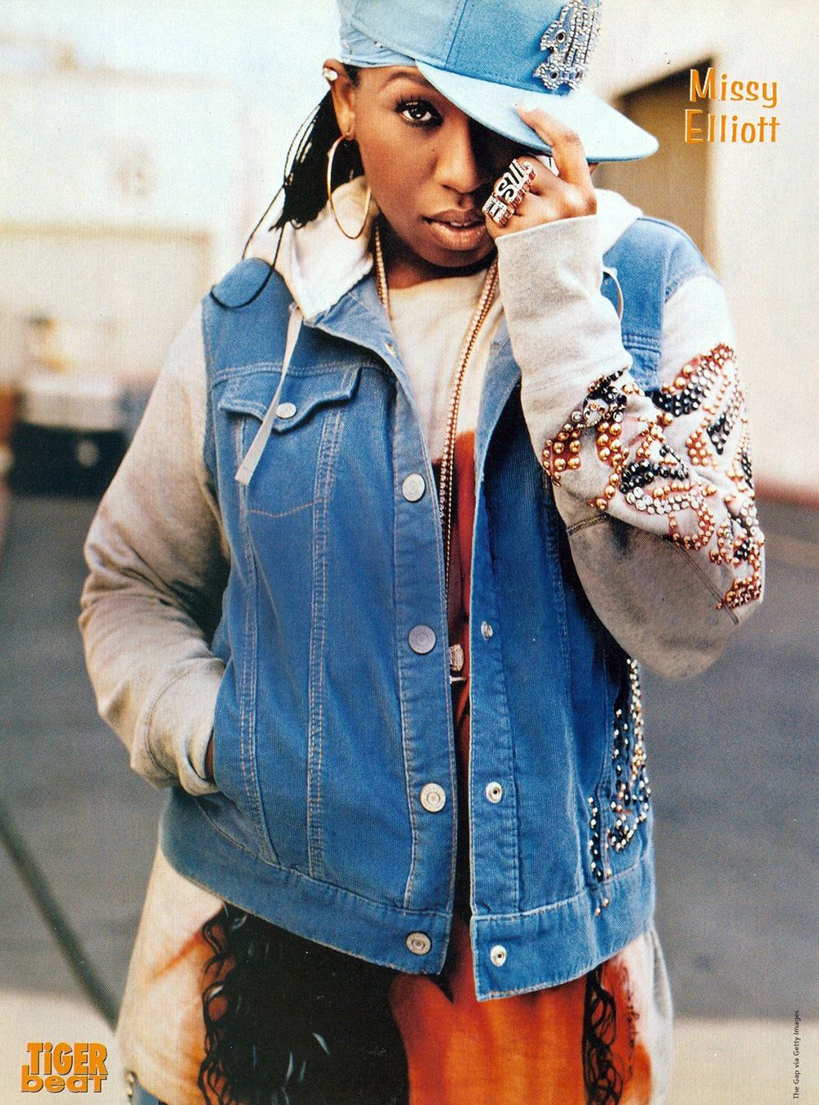
“More Masculine”
Young M.A., Missy Elliot, Queen Latifah, MC Lyte, Salt-N-Pepa, Lauryn Hill
Each of these artists represent female rappers who portrayed a more masculine persona in their language, clothes, and appearances.
Because Hip Hop was previously a male dominated industry, women had to conform to be successful.

Slide 21
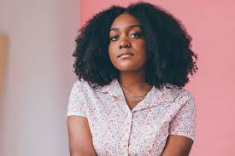
Noname
Achieved success without making herself “loud”
Paved a new way for women in hip-hop
rejecting the two normal routes to success
Has allowed her skill and lyricism to shine
despite being authentic, soft spoken, and poetic
Makes music from her experience as a Black woman
Often focuses on conscious, political topics
Has gone on musical hiatus following claims of possible early retirement
Cited frustrations with music industry, the artist-fan relationship, and playing for majority white crowds at concerts
Has shifted focus to activism and education
Notes:
Most prominent and one of the only modern female rappers to achieve high level success despite refusing to make herself loud
Has refused to make herself more masculine or hyper-sexualized
Skill in hip hop circles is often associated with masculinity/stereotypical masculine traits but Noname has made a name for herself by showcasing her skill in an authentic soft spoken, poetic manner.
These traits are not normally associated with successful female rappers
She makes her music out of her experience as a Black woman

Slide 22
“Song 33” by Noname
But n**** in the back quiet as a church mouse
Basement studio when duty calls to get the verse out
I guess the ego hurt now
It’s time to go to work, wow, look at him go
He really ‘bout to write about me when the world is in smokes?
When it’s people in trees?
When George was beggin’ for his mother, saying he couldn’t breathe
You thought to write about me?
Song responding to J. Cole’s “Snow on tha Bluff”
Noname tweet following George Floyd’s murder calling out rappers for not using their platform
J. Cole wrote a song discussing Noname’s tweets and “tone”
Noname further calls out Cole’s decision to focus on her rather than what is actually important

